Slide 1


Master’s Degree in Engineering in Computer Science Sapienza University of Rome Academic Year 2021-2022
Project Presentation for EvenTicket
Course: Laboratory of Advanced Programming
Professor: Prof. Mecella
Candidates: Carmignani Federico, Cicchetti Giordano, Brunetti Jacopo
ID number: 1845479, 1853840, 1856271

Slide 2

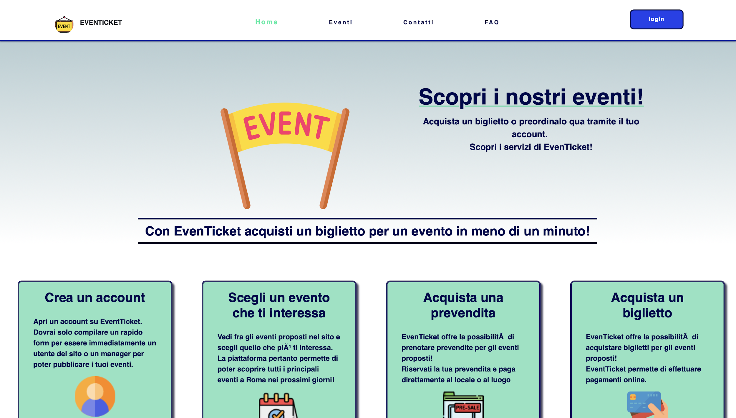
EvenTicket
A Website for Events
EvenTicket
Laboratory of Advanced Programming

Slide 3

INDEX
Requirements, Technologies and Architecture
Authentication Service and Storage
The Idea
The purpose of our project is to build a web application providing a set of services aimed at the management and proposals of events and distribution of tickets.
Event and Ticket Service
Notification service
EvenTicket
Laboratory of Advanced Programming

Slide 4
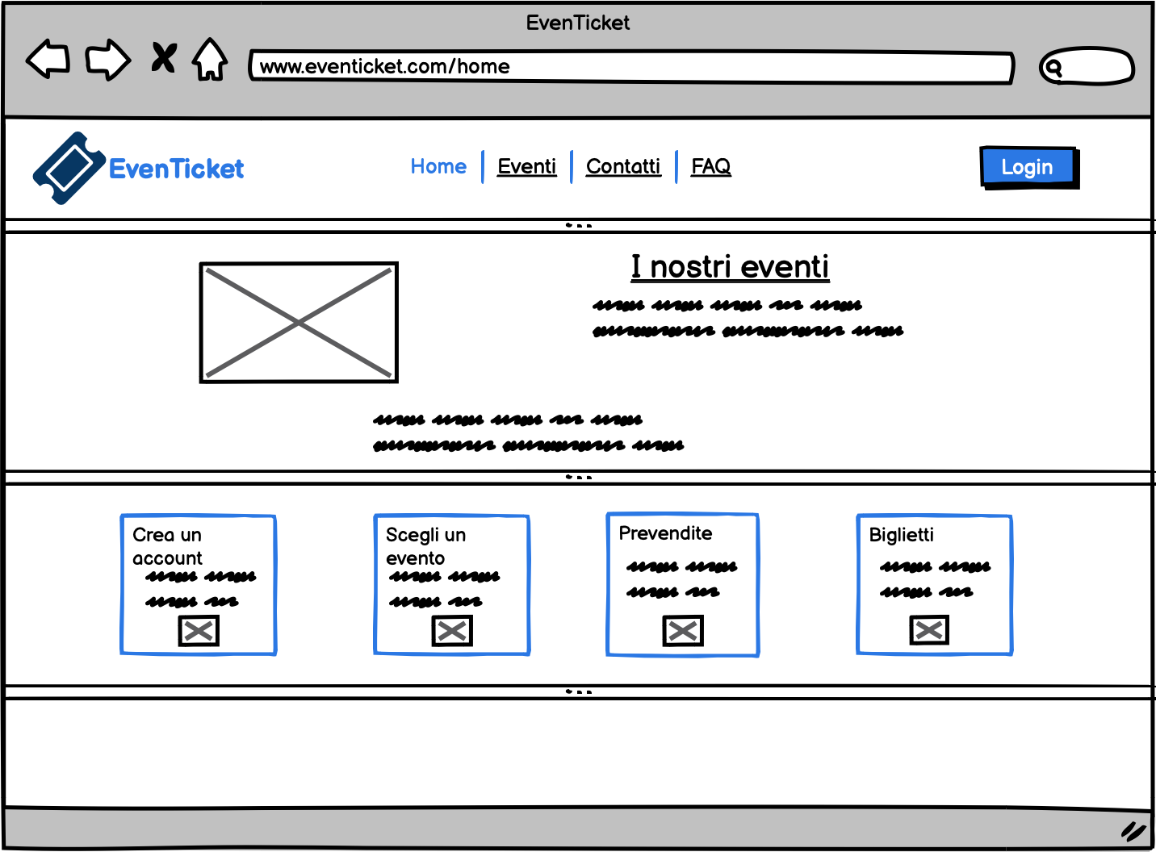
User Stories and Mockups The Requirements
The requirements that have been defined at the beginning were:
User Stories
Mockups
An example of mockup in a low fidelity mode by Balsamiq
EvenTicket
Laboratory of Advanced Programming

Slide 5
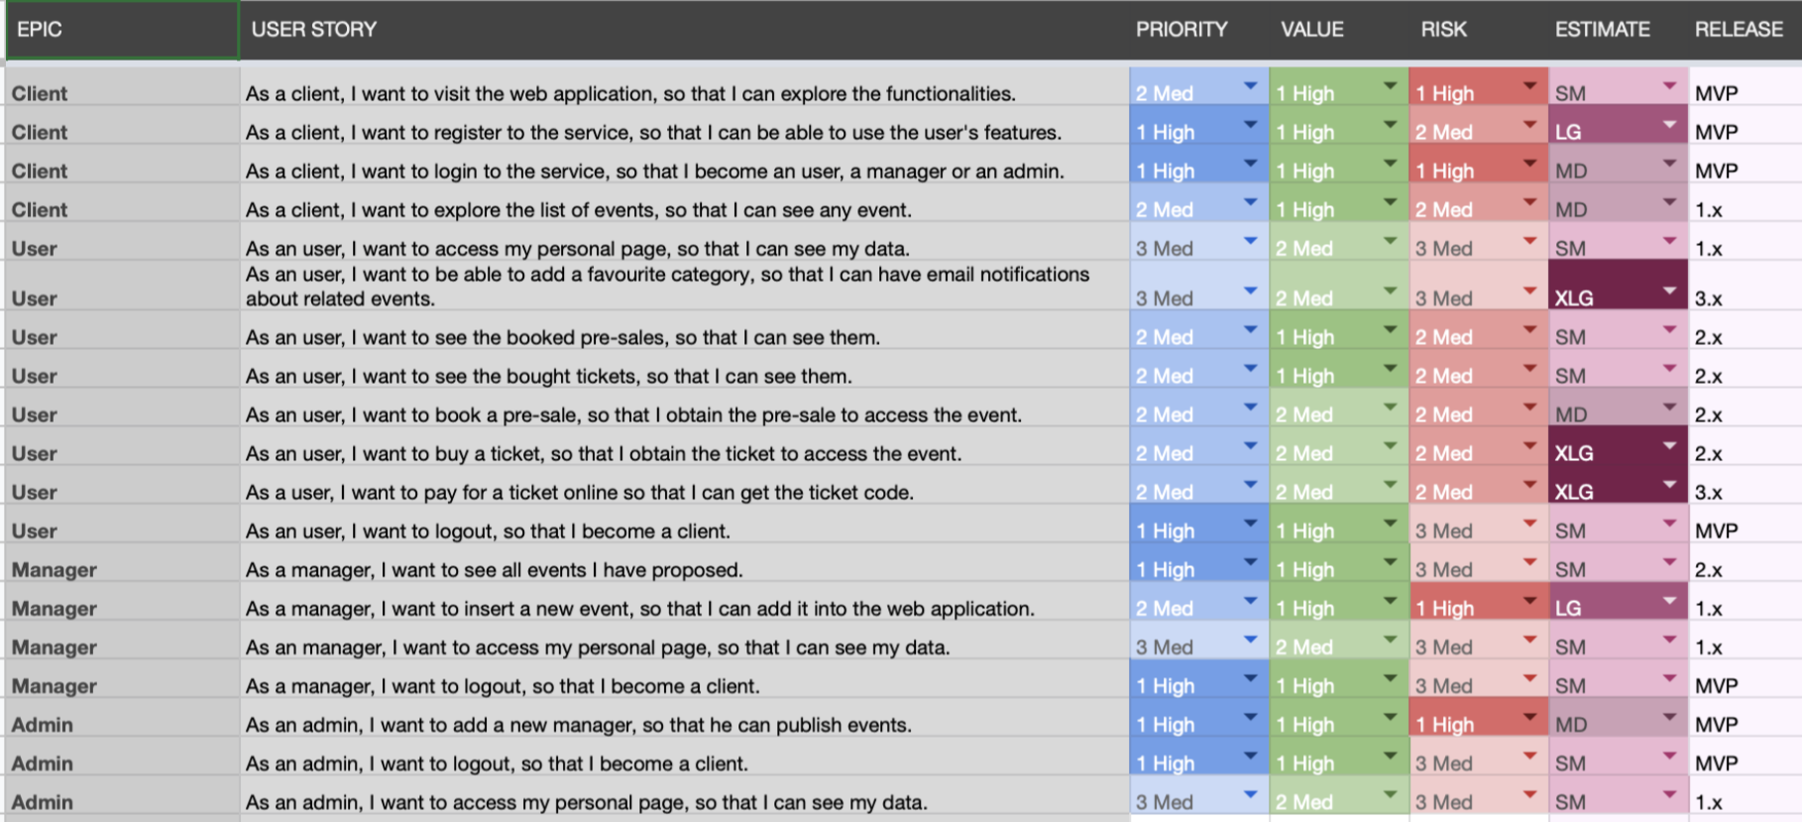
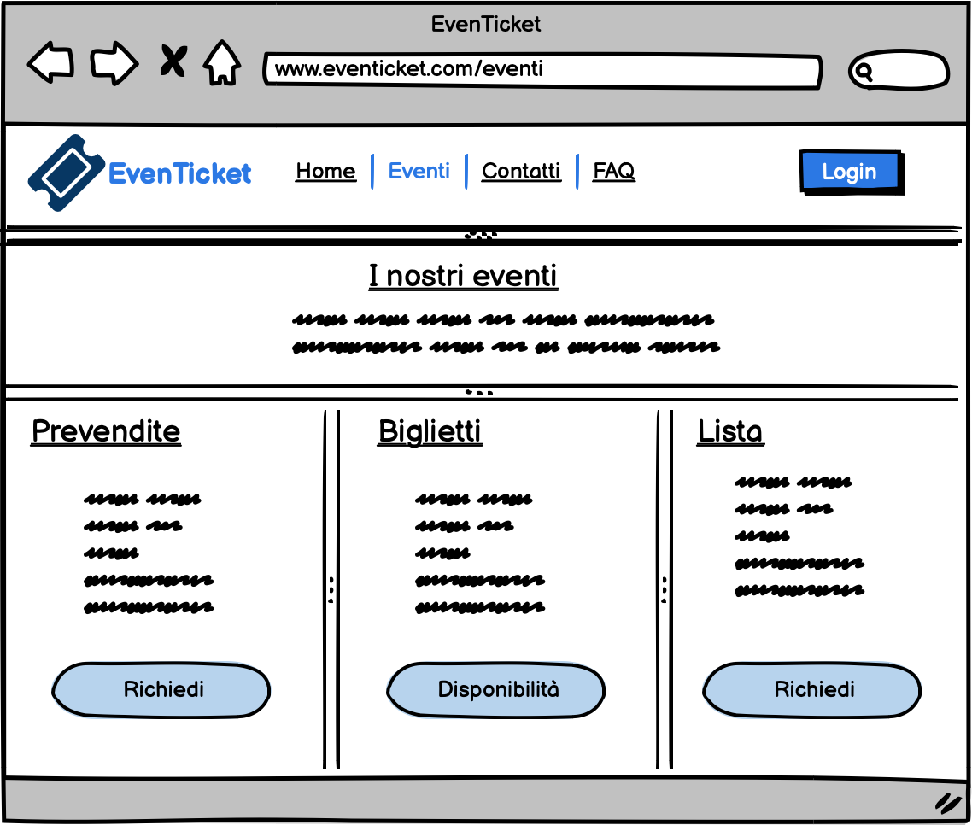
+
Another example of Mockup: the Events page
User Stories
Requirements
EvenTicket
Laboratory of Advanced Programming

Slide 6
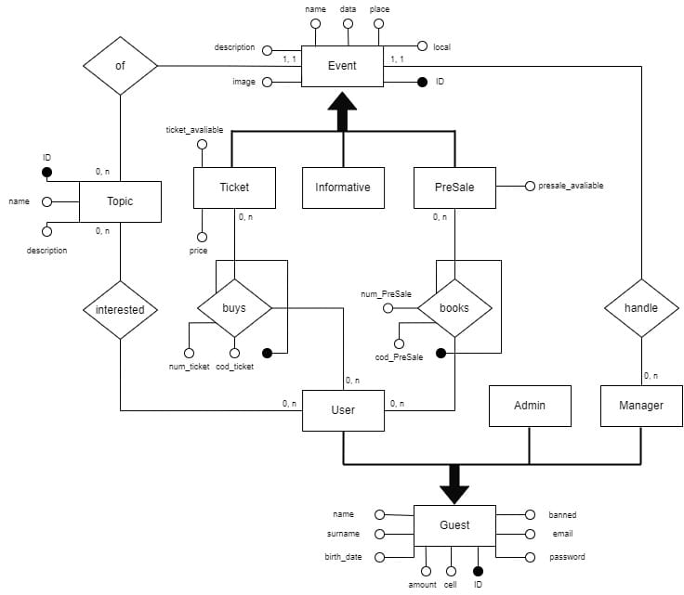
Audience and Scope
Managers
Users
Admin
Main functionalities
1)Publish events
2)Buy tickets or pre-sales
3)Admit new managers
The conceptual scheme
EvenTicket
Laboratory of Advanced Programming

Slide 7
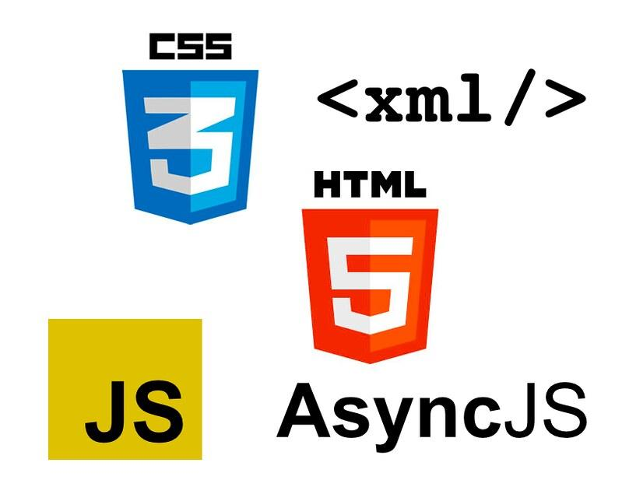





Technologies
Frontend
HTML, CSS and JavaScript
Backend
Containers’ technologies:
MongoDB and NGINX as API Gateway
Docker and Docker-Compose
Python and Node JS as languages
EvenTicket
Laboratory of Advanced Programming

Slide 8



The External Services
EvenTicket
Laboratory of Advanced Programming

Slide 9

Distribution:
Install Docker on your device!
Unzip the project in case of download!
Download or clone
from GitHub the
repository
Open a Terminal inside it and execute:
< docker compose up –build
Visit the website on localhost:80 using a Browser.
EvenTicket
Laboratory of Advanced Programming

Slide 10
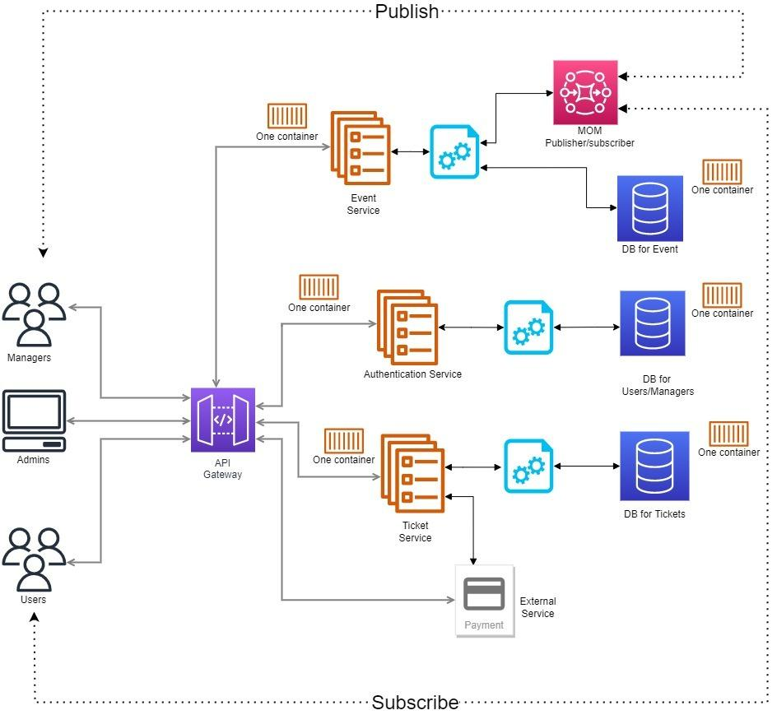
The Architecture
based on microservices
EvenTicket
Laboratory of Advanced Programming

Slide 11
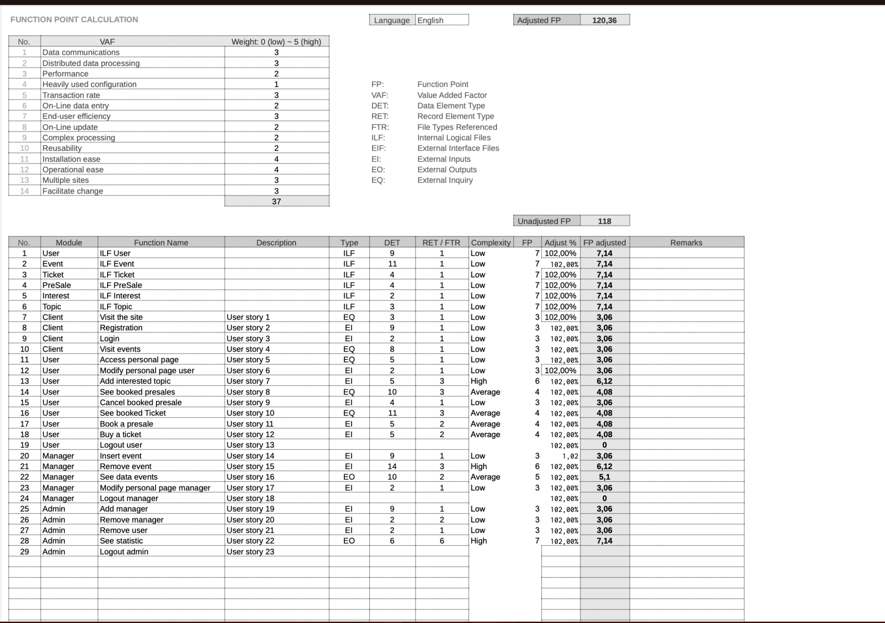
Complexity of Software Development
EvenTicket
Laboratory of Advanced Programming

Slide 12
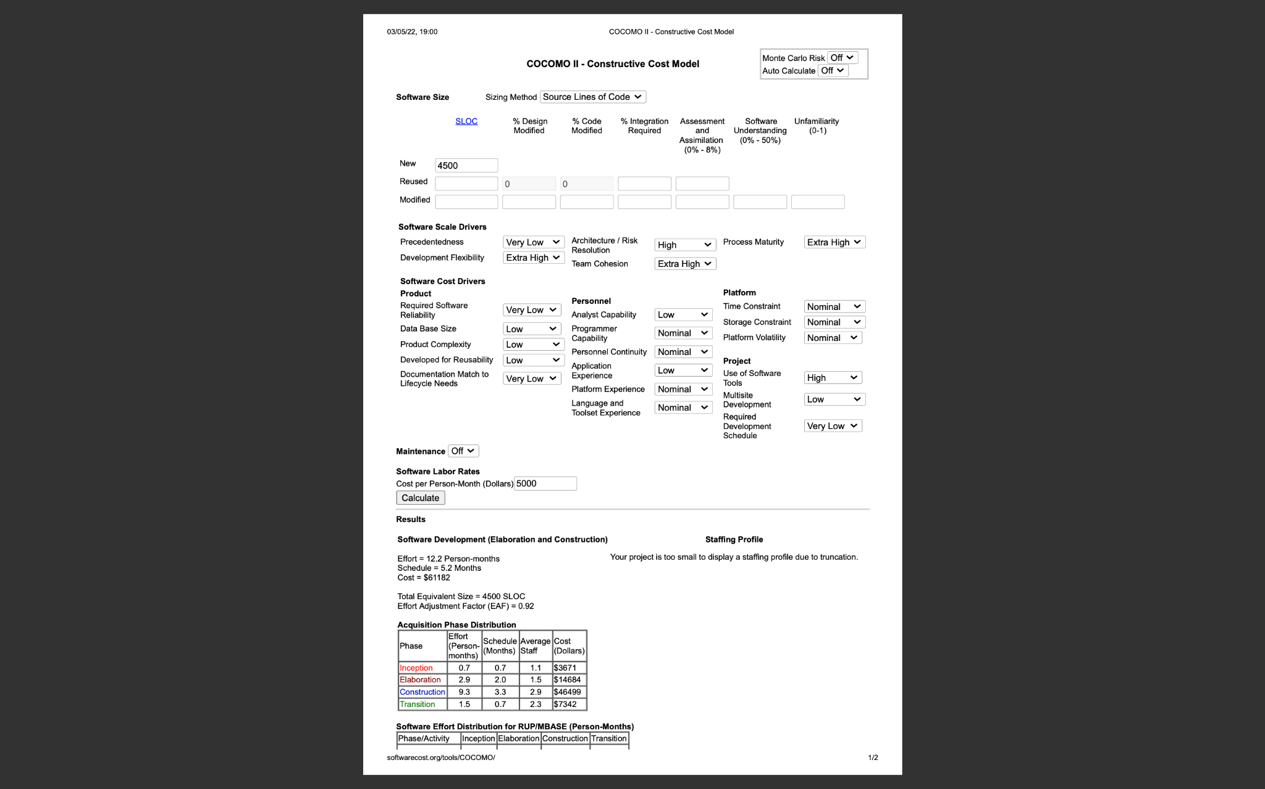
Complexity of Software Development
EvenTicket
Laboratory of Advanced Programming

Slide 13
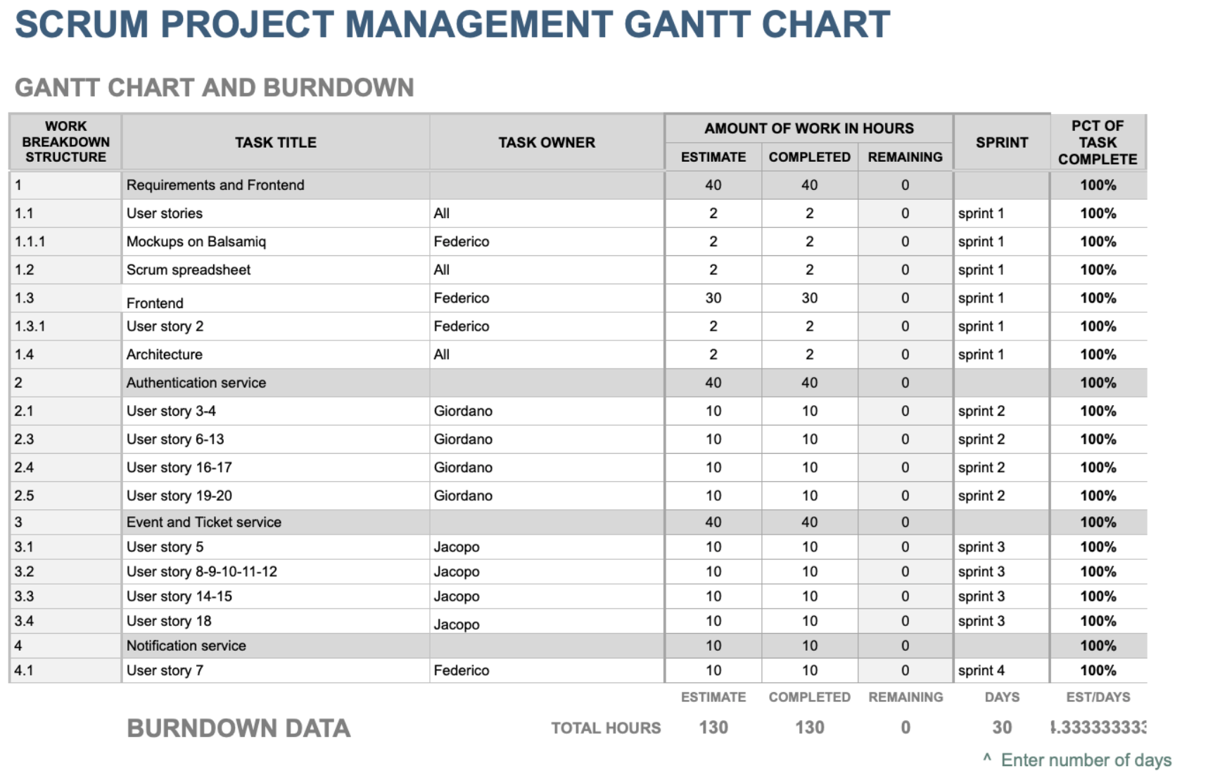
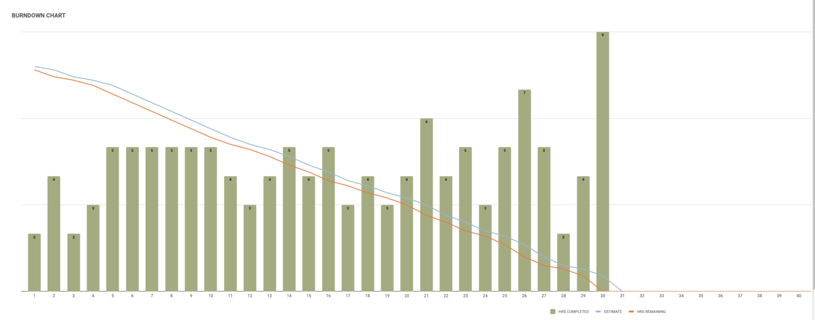
Development process based on SCRUM
EvenTicket
Laboratory of Advanced Programming

Slide 14
Authentication Service and Storage
Authentication Service
Storage
It Handles the registration of new Users or Managers
It permits the login of the various entities
It grant permissions to the various entities
One single container with a nodejs Server.
It is in charge to store the data in a permanent way
It retrieves the data when it is necessary
Dislocated in three containers:
Users
Events
Tickets
EvenTicket
Laboratory of Advanced Programming

Slide 15
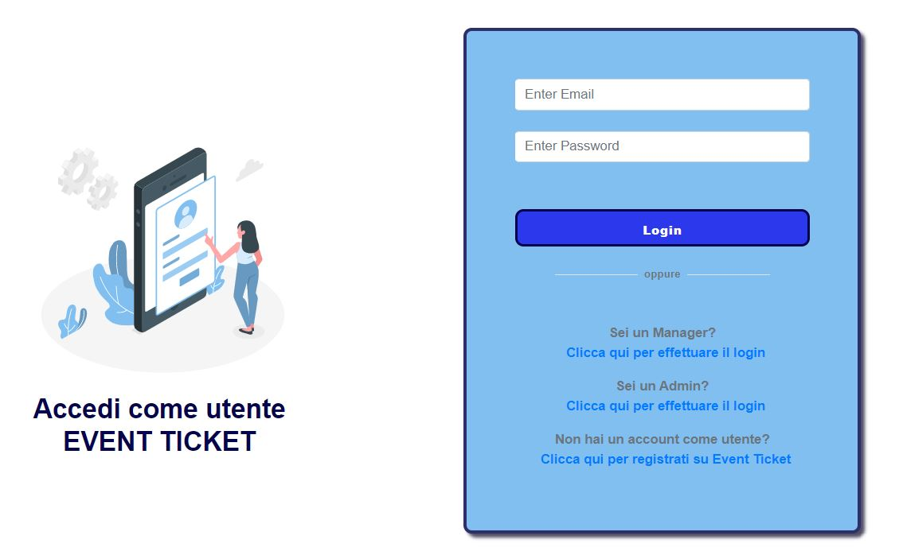
Authentication Service and Storage
Authentication Service
We have three types of entities:
Users
Managers
Admin
Each of this entity can log in inside the application through its specific login form
EvenTicket
Laboratory of Advanced Programming

Slide 16
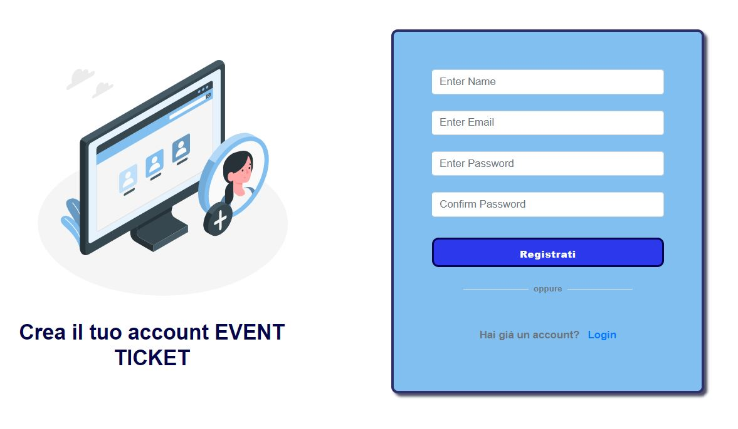
Authentication Service and Storage
Authentication Service
Everybody can create a new user through the registration form.
New managers are created only by the admin of the system.
The admin needs to be created by the developers at the first boot of the application, accessing the DB and creating the admin entity.
EvenTicket
Laboratory of Advanced Programming

Slide 17
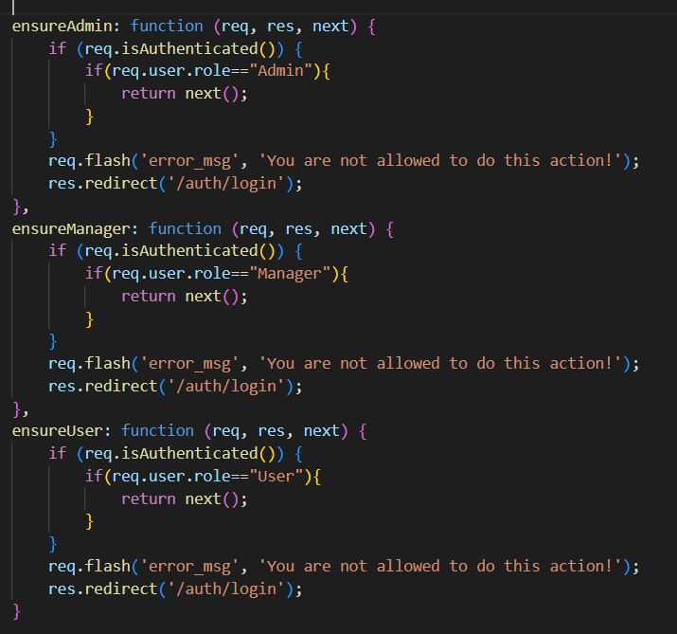
Authentication Service and Storage
Authorization Service
The container for Authentication is also used for guarantee permissions to the entities in a RBAC style.
(ROLE BASE ACCESS CONTROL)
To each entity is associated a flag in the corresponding db record that individuates the role:
User
Manager
Admin
One single relation in the DB
EvenTicket
Laboratory of Advanced Programming

Slide 18
Authentication Service and Storage
Storage
The DB is implemented in MongoDB
Three different containers each of them running an instance of MongoDB
The first to store data about entities (Users|Managers|Admin)
The second for the Events
The third for the tickets
Why MongoDB?
NoSQL
Flexibility
Scalability
Very easy to connect, query and retrieve data.
High availability of libraries for the various programming languages
EvenTicket
Laboratory of Advanced Programming

Slide 19


Event and Ticket Services
Event Service
Ticket Service
Handle the created Events
Manage Event Database
Create and handle TIcket codes
Gives the possibility to pay for tickets
Manage Ticket Database
EvenTicket
Laboratory of Advanced Programming

Slide 20


Event and Ticket Services
Event Service
Types of events:
‘Biglietto’
‘Prevendita’
‘Informativo’
Event data:
event related data
ticket related data
Each event has a category
Cinema, Cultura, Discoteca, Musica, Teatro, Sport
EvenTicket
Laboratory of Advanced Programming

Slide 21

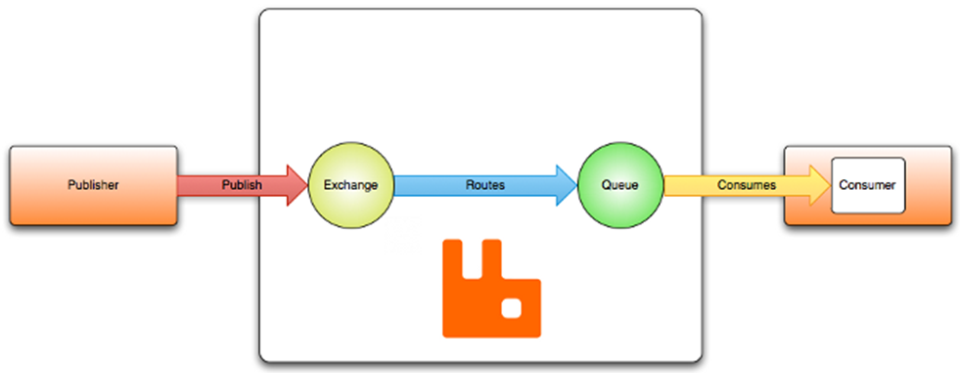


Notification Service
AMQP - Sendgrid
Use of AMQP Cloud to manage the queue
New event ⟹ Email to the interested parties
EvenTicket
Laboratory of Advanced Programming

Slide 22



Event and Ticket Services
Ticket Service
Ticket stands for both:
any purchased ticket
any pre-sale booked
Structure of ticket code ⟹ HASH functions
It connects with the payment external service
EvenTicket
Laboratory of Advanced Programming

Slide 23
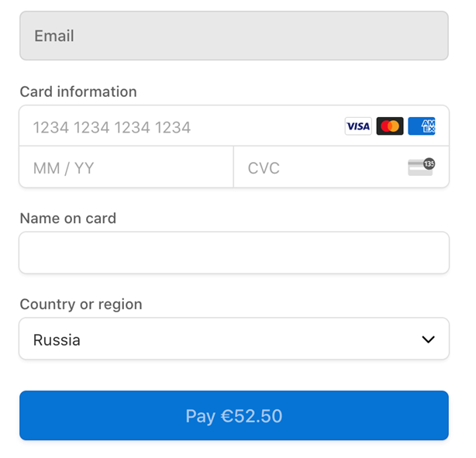
Event and Ticket Services
Payment External Service - Stripe
Manages and Accepts online transactions
Guarantees security for user
In the specific case is used ‘Testing Stripe’
EvenTicket
Laboratory of Advanced Programming

Slide 24

AND NOW A QUICK DEMO ABOUT IT..
EvenTicket
Laboratory of Advanced Programming

Slide 25
Master’s Degree in Engineering in Computer Science Sapienza University of Rome Academic Year 2021-2022
Thank you for your attention!
Course: Laboratory of Advanced Programming
Professor: Prof. Mecella
Candidates: Carmignani Federico, Cicchetti Giordano, Brunetti Jacopo
ID number: 1845479, 1853840, 1856271

